Slide 1
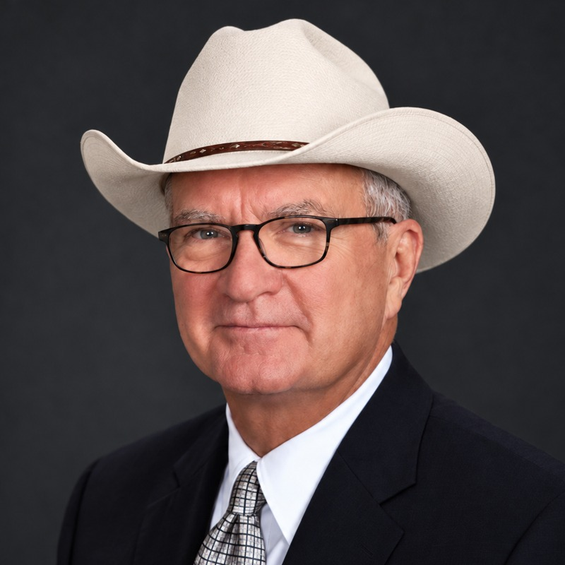
AI and Aging Well
How artificial intelligence is changing life for seniors and the people who care for them
D Dub | The AI Cowboy
Notes:
About 45 seconds. Introduce yourself: D Dub, CPA, 30-plus years running businesses, now writing The AI Cowboy every Sunday. Promise for the next 10 minutes: no jargon, just what AI is already doing for seniors and caregivers, where the danger is, and how to stay on top of it.

Slide 2

Why this matters right now
63M
+45%
44%
Americans are family caregivers, about 1 in 4 adults
growth in family caregivers since 2015, nearly 20 million more
of caregivers provide high-intensity care
And the need is growing: the oldest baby boomers reach age 80 in 2026.
Source: AARP & National Alliance for Caregiving, Caregiving in the U.S. 2025 (released July 2025)
Notes:
About 1 minute. The AARP and National Alliance for Caregiving report found 63 million family caregivers, a 45 percent jump in ten years. 44 percent provide high-intensity care. AARP points out the oldest boomers turn 80 this year, so the need keeps climbing. That is the backdrop: more people needing care, more families stretched thin. That is exactly where AI is starting to help.

Slide 3
Seniors are already using AI
8 in 10
adults 50+ have used some form of AI, mostly at a beginner level
51%
use or are interested in voice assistants
43%
use or are interested in AI health-monitoring devices
Sources: AARP 2026 Tech Trends and Adults 50-Plus (survey Sept-Oct 2025); AARP Research AI data story (Jan 2026)
Notes:
About 1 minute. Generative AI use among people 50-plus went from 9 percent in 2023 to 18 percent in 2024 to 30 percent in 2025. It has roughly doubled each year. AARP also reports eight in ten adults 50-plus have used some form of AI, but most call themselves beginners. Voice assistants and health monitors are where the interest is. Point: this is not a young person's thing anymore.

Slide 4



Benefit 1: Better health support
AI is already in the exam room
81% of physicians now use AI at work, mostly for notes, research summaries and discharge instructions (AMA, 2026).
Seniors are asking AI health questions
41% of AI users age 50+ have asked an AI tool a health question (AARP AI & Health series, 2026).
Everyday devices are becoming medical aids
In Sept 2024 the FDA authorized the first over-the-counter hearing aid software, for Apple AirPods Pro, for mild-to-moderate hearing loss.
Sources: AARP, AI Usage by Health Care Providers (2026, citing AMA physician survey); AARP AI & Health 50+ Consumer Pulse; U.S. FDA (Sept 12, 2024)
Notes:
About 1 minute 15 seconds. Your doctor is probably already using AI: the AMA found 81 percent of physicians do, mainly for paperwork. But AARP found only 9 percent of older adults have been told about it, and 9 in 10 say they have a right to know. So it is fair to ask your doctor. Second, 41 percent of older AI users have asked it a health question. Third, AirPods Pro can now work as an FDA-authorized over-the-counter hearing aid. Technology many people already own is turning into a health tool.

Slide 5

Benefit 2: Safer at home and in senior living
What operators are reporting in 2026
Published pilot study
48%
fewer falls, 54% fewer hospitalizations over 10 months (Solera Senior Living with Inspiren)
80%
76%
lower fall rate over six months (Sagora Senior Living with Teton)
fewer emergency department visits (and 75% fewer EMS visits) after AI video fall detection for residents living with dementia
Company-reported results, not peer-reviewed. Promising, but ask for the data.
American Journal of Managed Care
Sources: Xiong et al. pilot, American Journal of Managed Care (SafelyYou); Solera/Inspiren announcement (Mar 2026); Teton case study, Sagora Senior Living
Notes:
About 1 minute 15 seconds. Falls are a top fear for families. A pilot published in the American Journal of Managed Care found AI video fall detection cut emergency department visits by 80 percent among residents with dementia. Senior living operators are reporting big drops in falls too, 48 percent at Solera, 76 percent at a Sagora community. Be honest with the room: those are company announcements, not peer-reviewed studies. If you are touring a community, ask whether they use this and ask to see their numbers.

Slide 6

Benefit 3: A companion against loneliness
ElliQ is a tabletop AI companion that starts conversations, remembers what you tell it, and reminds you about medications and exercise.
95%
92%
3,500+
reduction in loneliness reported by the New York State Office for the Aging program
of users find the companion useful (2026 program data)
older New Yorkers applied in 2025 alone; the state extended the program in Oct 2026
Sources: NY State Office for the Aging (2023 report, 2026 report); The Robot Report (Oct 13, 2026); Spectrum News (May 2026), cost about $600-$1,000 per year
Notes:
About 1 minute. Loneliness is a real health risk. New York's Office for the Aging has been giving ElliQ to older adults since 2022 and reported a 95 percent reduction in loneliness. Its 2026 data shows 92 percent find it useful, demand is strong, and the state just extended the program this month. The company says ElliQ always presents itself as AI and does not pretend to be human. It is a supplement to people, not a replacement. Spectrum News put the cost at roughly 600 to 1,000 dollars a year.

Slide 7

Benefit 4: A new helper for caregivers
Caregivers are leaning in
Practical uses today
21%
use AI several times a week or daily for health info (vs. 12% of patients)
Translate medical jargon from test reports into plain English
Research symptoms and medication side effects before calling the doctor
Build daily schedules and checklists for a loved one
Compare home-safety gadgets and services
77%
would try AI health monitoring for a loved one
22%
of family caregivers have had formal training, so the knowledge gap is real
Sources: CMI Media Vitals via eMarketer (2026); LogicMark / Talker Research survey (Apr 2026); AARP & NAC Caregiving in the U.S. 2025; AARP, How AI Can Help Caregivers (Oct 2025)
Notes:
About 1 minute. Caregivers are some of the most active AI users: CMI found 21 percent use it several times a week or daily for health information, compared to 12 percent of patients. Their top uses are researching symptoms and side effects. A LogicMark survey found 77 percent would try AI health monitoring. And only 22 percent of family caregivers have had formal training, so a tool that explains things in plain English fills a real gap. AARP profiled a caregiver using AI to decode an echocardiogram report and build visual daily schedules for her mom.

Slide 8



The dark side: AI-powered scams
Protect your family
$7.75B
Set a family code word
The FBI recommends one for any emergency money request.
lost by Americans 60+ to online fraud in 2025, up 59% in one year
Hang up and call back
$38,500 average loss per senior victim
3,100+ senior complaints mentioned AI, with $352M+ lost
Voice cloning powers fake “grandchild in trouble” calls
Use a number you already know, never the one that called you.
Get help fast
Elder Fraud Hotline: 833-FRAUD-11 (833-372-8311)
Sources: FBI Internet Crime Complaint Center 2025 Elder Fraud Report (Apr 2026); U.S. Department of Justice National Elder Fraud Hotline
Notes:
About 1 minute 15 seconds. Same technology, bad hands. The FBI's 2025 report: people 60 and older reported 7.75 billion dollars in losses, up 59 percent, with an average loss of about 38,500 dollars. Over 3,100 senior complaints referenced AI, with more than 352 million lost. Scammers clone a grandchild's voice from social media and call in a panic. Three defenses: a family code word, hang up and call back on a number you know, and the National Elder Fraud Hotline at 833-FRAUD-11.

Slide 9



Using AI wisely: trust, but verify
69%
68%
9 in 10
of adults 50+ are not comfortable sharing personal health info with an AI tool
worry AI may reduce human interaction
say patients have a right to know when AI is used in their care
Start small
Check with a pro
Guard your info
Keep people first
One task: a reminder, a recipe, a letter
Run health answers past your doctor
Skip SSNs, account numbers, passwords
AI supports care; it does not replace it
Sources: AARP AI & Health 50+ Consumer Pulse (2026); AARP AI survey (Jan 2025); AARP, AI Usage by Health Care Providers (2026)
Notes:
About 1 minute. Older adults are rightly cautious: 69 percent are not comfortable sharing health info with an AI tool, 68 percent worry it reduces human contact, and 9 in 10 want to be told when AI is used in their care. That caution is healthy. Four simple habits: start with one small task, check health answers with your doctor, never type in sensitive numbers, and keep people at the center.

Slide 10

Stay in the saddle with The AI Cowboy
Roping the week's AI news into one Sunday read
Free, every Sunday, in plain English
New tools, scam alerts, and what actually matters
Subscribe: dward@ddub.ai
Notes:
About 45 seconds. AI changes every week, and most people do not have time to follow it. That is why I write The AI Cowboy: one plain-English email every Sunday, out of Fort Worth, covering the new tools, the scams to watch for, and what actually matters for you and your family. It is free; just email me at dward@ddub.ai to subscribe. Thank you, and I am happy to take questions.

Slide 11
Sources
AARP & National Alliance for Caregiving, Caregiving in the U.S. 2025 (July 2025) - aarp.org
AARP, 2026 Tech Trends and Adults 50-Plus (survey of 3,838 adults, Sept-Oct 2025)
AARP Research, AI awareness and usage among adults 50+ (Jan 2026); AARP AI survey (Jan 2025)
AARP, AI & Health: 2026 50-Plus Consumer Pulse Series (NORC); AI Usage by Health Care Providers (2026)
U.S. FDA, authorization of first OTC hearing aid software, Apple AirPods Pro (Sept 12, 2024)
Xiong et al., AI video fall detection pilot, American Journal of Managed Care (SafelyYou)
Solera Senior Living / Inspiren announcement (Mar 2026); Teton case study, Sagora Senior Living
NY State Office for the Aging, ElliQ reports (2023, 2026); The Robot Report (Oct 13, 2026)
CMI Media Vitals via eMarketer (2026); LogicMark / Talker Research caregiver survey (Apr 2026)
FBI Internet Crime Complaint Center, 2025 Elder Fraud Report (Apr 2026); DOJ Elder Fraud Hotline
Notes:
Reference slide; not presented. Leave up during Q&A or share with attendees.

